Slide 1
Recursion Algorithm

Slide 2
Definition
The process in which a function calls itself directly or indirectly is called recursion and the corresponding function is called a recursive function.

Slide 3
Properties of Recursion:
Performing the same operations multiple times with different inputs.
In every step, we try smaller inputs to make the problem smaller.
Base condition is needed to stop the recursion otherwise infinite loop will occur.

Slide 4
Algorithm:Steps Step1 Define a base case:Identify the simplest case for which the solution is known or trivial. This is the stopping condition for the recursion, as it prevents the function from infinitely calling itself.

Slide 5
Step2 - Define a recursive case: Define the problem in terms of smaller sub problems. Break the problem down into smaller versions of itself, and call the function recursively to solve each sub problem.
Step3 - Ensure the recursion terminates: Make sure that the recursive function eventually reaches the base case, and does not enter an infinite loop.
Step4 - Combine the solutions: Combine the solutions of the sub problems to solve the original problem.

Slide 6
A Mathematical Interpretation
Determine the sum of first n natural numbers
approach(1) – Simply adding one by one
f(n) = 1 + 2 + 3 +……..+ n
approach(2) – Recursive adding
f(n) = 1 n=1
f(n) = n + f(n-1) n>1

Slide 7
How are recursive functions stored in memory?
Recursion uses more memory, because the recursive function adds to the stack with each recursive call, and keeps the values there until the call is finished.
The recursive function uses LIFO (LAST IN FIRST OUT)

Slide 8
What is the base condition in recursion?
int fact(int n)
{
if (n < = 1) // base case
return 1;
else
return n*fact(n-1);
}

Slide 9
What is the difference between direct and indirect recursion?
A function fun is called direct recursive if it calls the same function fun.
A function fun is called indirect recursive if it calls another function say fun_new and fun_new calls fun directly or indirectly.

Slide 10
// An example of direct recursion
void directRecFun()
{
// Some code....
directRecFun();
// Some code...
}

Slide 11
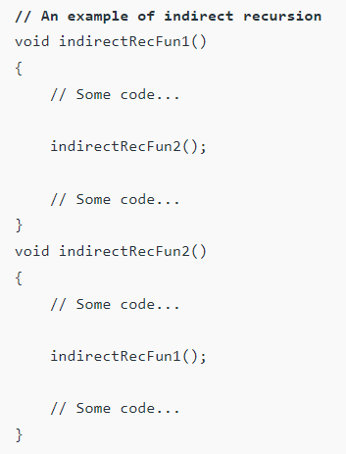

Slide 12
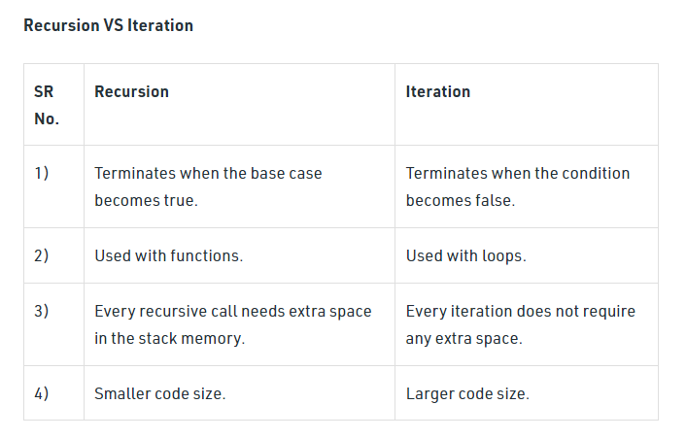

Slide 13
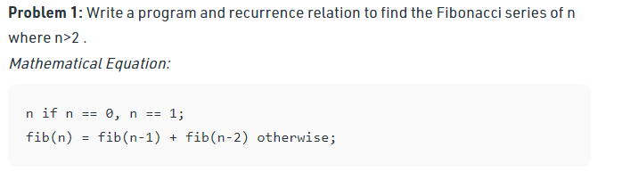

Slide 14
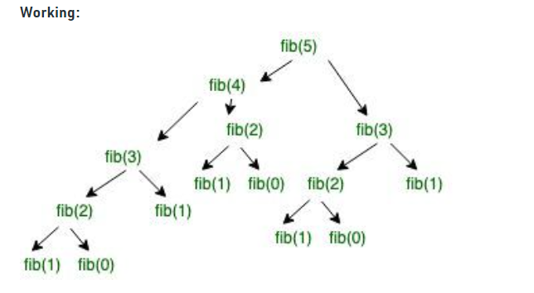

Slide 15
Non Recursion Algorithm
1.Find largest element in the array
int maximum(int arr[],int n)
{
int i,max=0;
for(i=0;i<n;i++)
{
if(arr[i]>max)
max=arr[i];
}
return max;
}

Slide 16
2. Element Uniqueness Problem
Unique Elements(A[0….n-1])
for i 0 to n-2 do
for j i+1 to n-1 do
if A[i]=A[j] return false
return true

Slide 17
Matrix multiplication
for i=0 to n-1 do
for j=0 to n-1 do
c[i][j] 0
for k=0 to n-1 do
c[i][j]=c[i][j]+a[i][k]*b[k][j];

